Slide 1
The objective of this project is to determine how is the implementation of the existing strategies affecting the rate of COVID-19 inflation. That is to find out the effect of applied regulations on the spread of the Covid-19 virus ,is the number of cases increasing or decreasing during this lockdown regulations?

Slide 2
here are some of the strategies applied by most countries
01
Ban international travel
1.1.Restricting internal movements
1.2 closing public. Transport
1.3 staying Home
02
Closing of workplaces
2.1.Closing schools and
2.2 Closing of universities
03
Cancelling public events
3.1 cancelling any Meetings
3.2 place of worships
04
Restriction on Gatherings

Slide 3
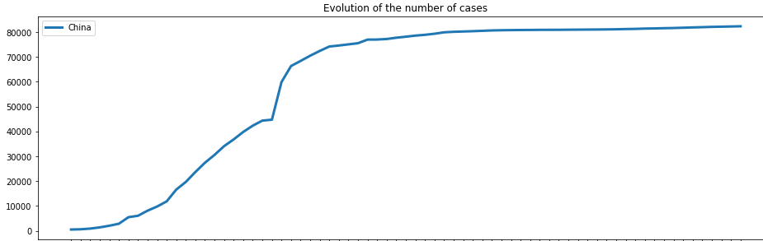
Methodology
Our idea was to determine the rate at which the curve on the right flattens or expand as more regulations or strategies are being implemented.
As this is a continuous problem , we had devised
A machine learning algorithms that uses recorded
Dataset as from January to determine the
Actual Predictions on cases ,as most Algorithms
improve their accuracy by,
any changes in features being added or
Subtracted
Using that we will be able to tell the effects

Slide 4
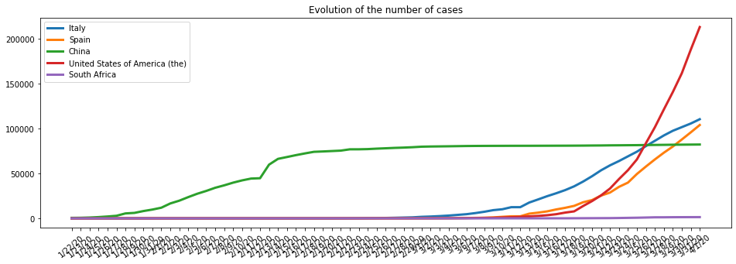
SOLUTIONS
We have found that there is a relationship between implemented strategies and rate of infection.
This relationship is better seen in countries that have implemented strong policies
With the model we can simply conclude that with the current strategies being implemented the rate of cases decreases
We used China as our training country as they were the first country to implement measures, comparing them against other countries such as USA and ITALY their curve as flattened better

Slide 5
impact
We seek to use our skills to make an impact to societies, communities and global by providing solutions to everyday socio -eco challenges,
Providing insights and advices
Using data and digital skills to bring about innovations
To educate people

